Slide 1
Princeton Science Results from the Apache Point 3.5m Telescope
Michael Strauss

Slide 2
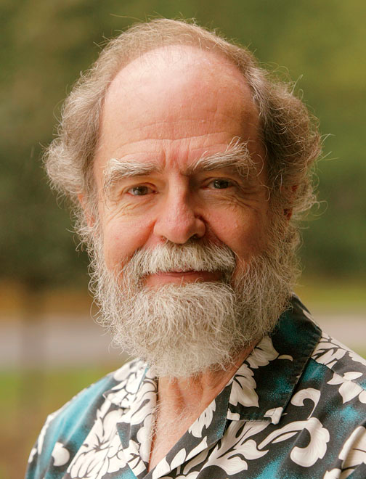
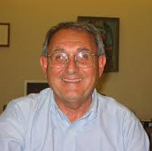
1100 Nights, 20 years
Princeton astronomers have been involved in APO and ARC from the beginning.
Jim Gunn Jerry Ostriker Al Sinisgalli

Slide 3
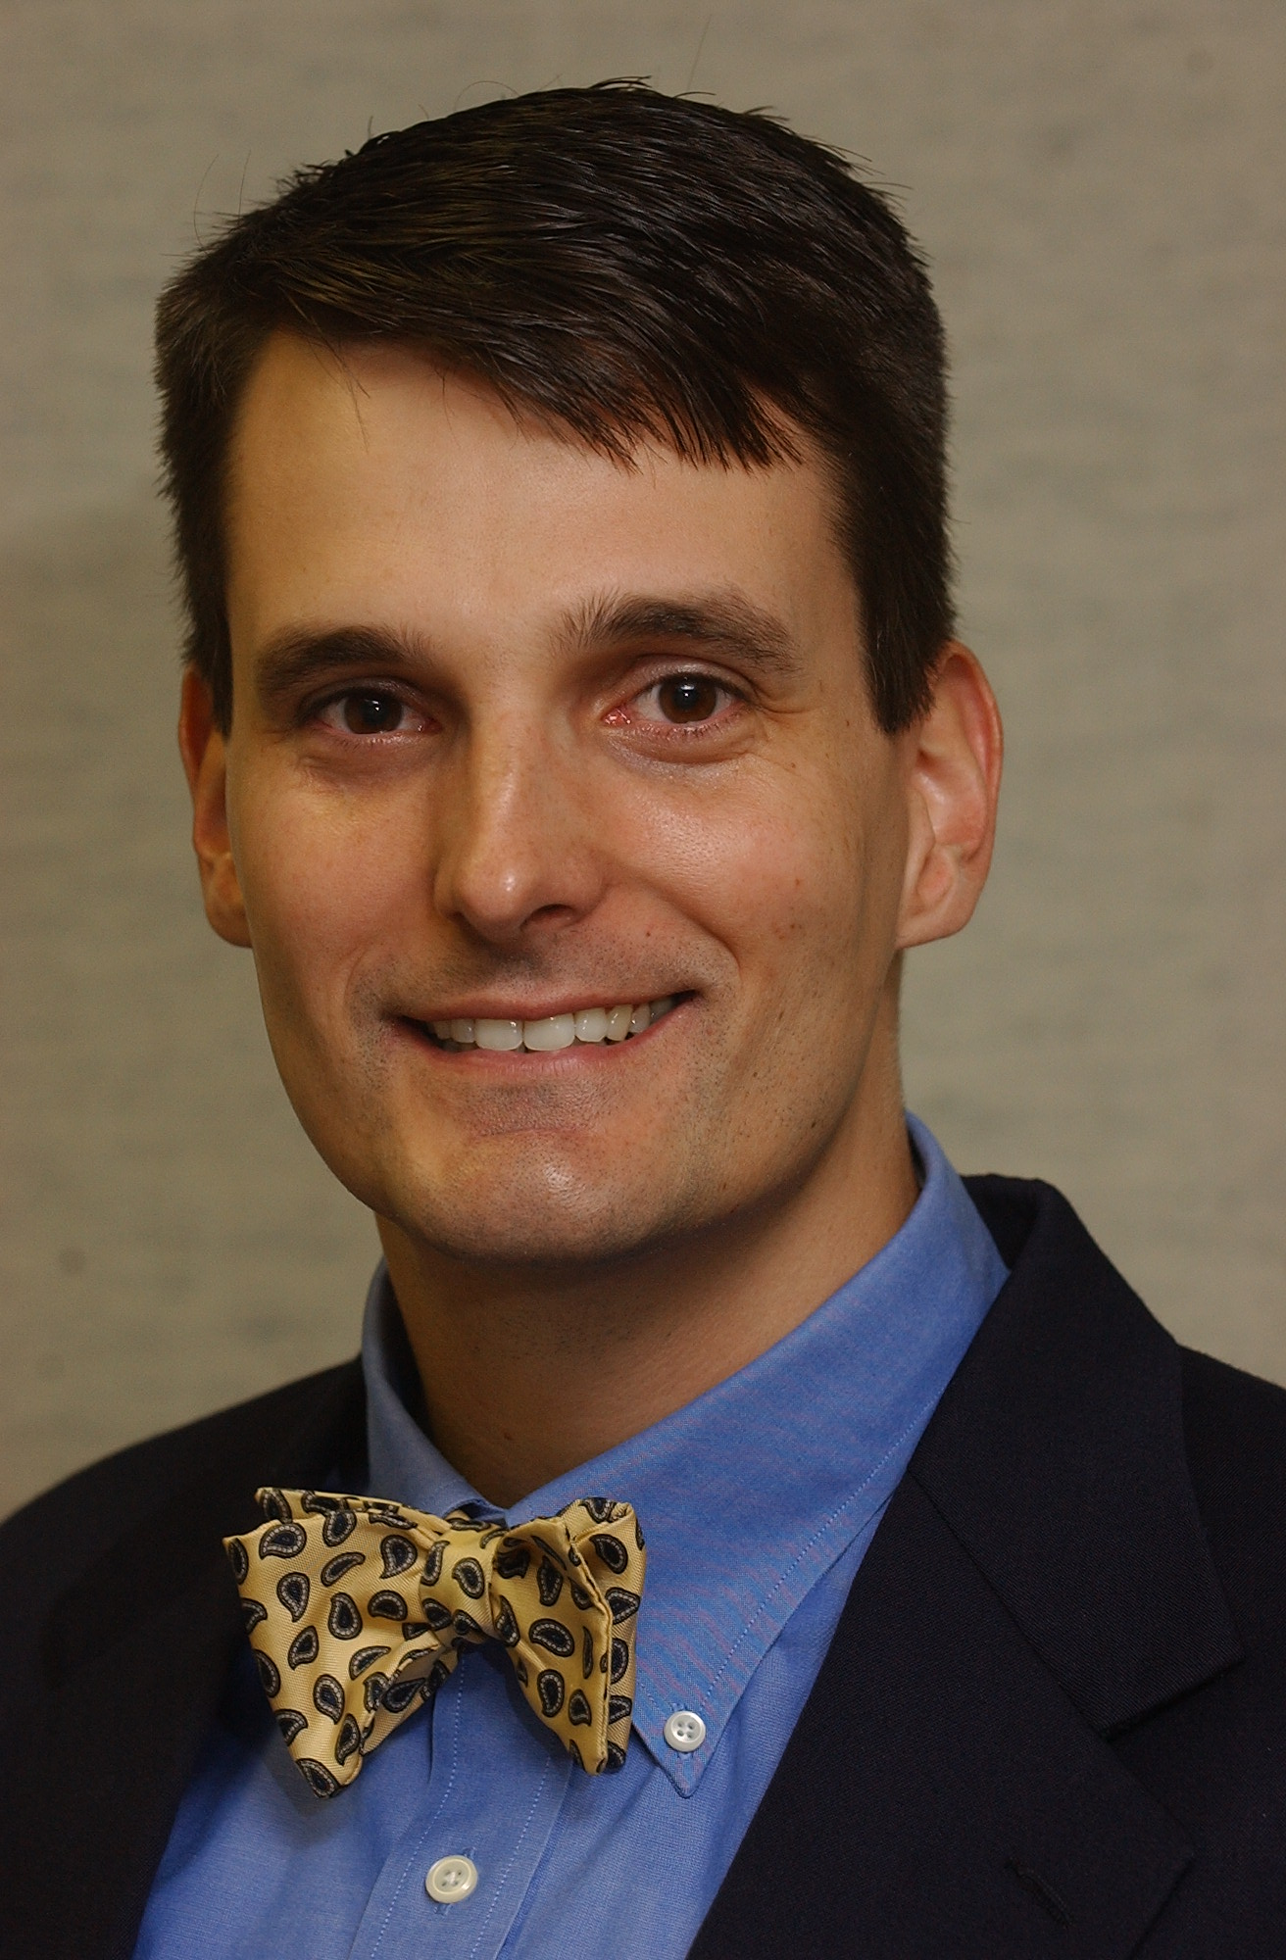
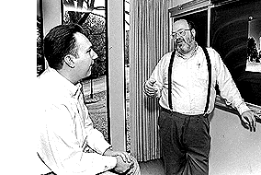
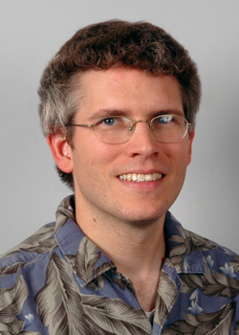
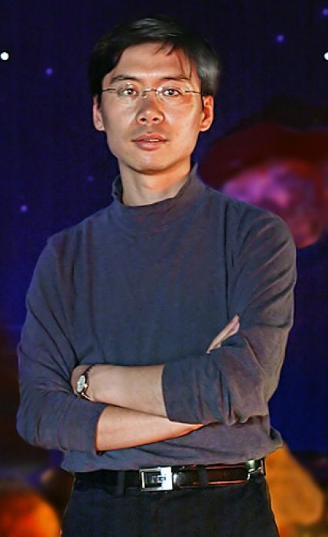
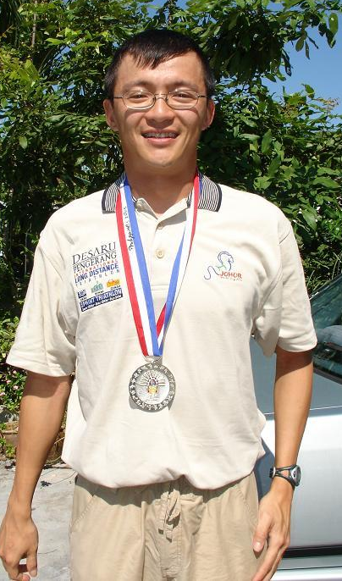
90+ papers, 11 PhD Thesis students
Tomislav Kundic (with Ed Turner), Wes Colley, James Rhoads, Xiaohui Fan, Yeong Loh, Bart Pindor

Slide 4
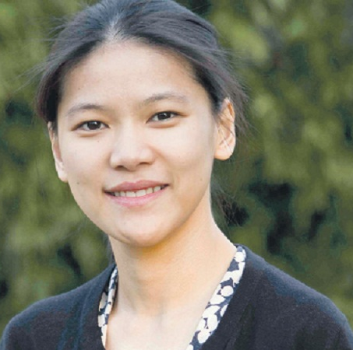
Joe Hennawi, Xin Liu, Reina Reyes, Pete Pattarakijwanich, and Chelsea Huang

Slide 5
Major Scientific Themes:
Follow-up of surveys: SDSS!, Palomar Transient Factory, ASAS-SN, HAT, ACT.
Quasars: Lensed, high redshifts, pairs, absorption lines….
Dynamical studies of nearby galaxies
Cool stars and brown dwarfs
White dwarfs, carbon stars
Transients and supernovae
Extrasolar planets

Slide 6
Time Delay in a Gravitational Lens (Kundic et al. 1997)
Gravitationally lensed quasar pair

Slide 7
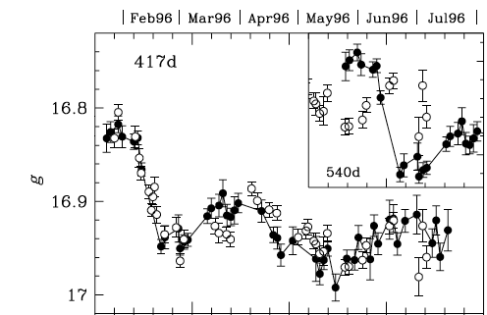
Monitoring the brightness of the two over a year, as observed. Notice that the brightness changes significantly with time.
The two are out of phase by 420 days. This gives a measure of the geometry of the lens, leading to a (correct) determination of the expansion rate of the Universe.

Slide 8
The Most Distant Quasars in the Universe (Fan et al. 2001)
All we had to do was to find the reddest objects in the SDSS….

Slide 9
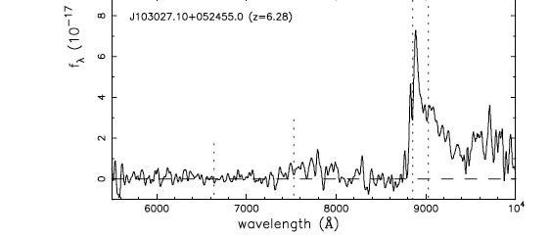
We always seemed to break our redshift record on the crappiest nights…
Quasars seen when the universe was 6% of its present age…

Slide 10
The nearest stars in the Universe were often confused with the most distant quasars…

Slide 11
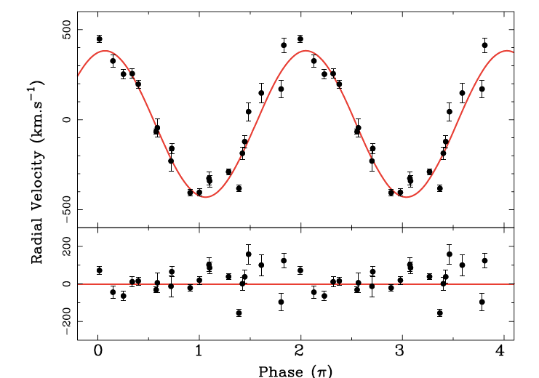
Orbiting Pairs of White Dwarfs: Progenitors to a Supernova Explosion? (Mullally et al. 2009)
Measurements of the motions of the two stars, whipping around each other once an hour at more than one million miles per hour!

